Slide 1
Polling Stations
- finalization & setting up

Slide 2
Polling Stations
1. DEO is responsible for making provision for polling stations and publication of the list of polling stations.
2. In case of adoption of existing list of polling stations, no fresh approval of the Commission is necessary and Commission be intimated accordingly.
3.In case of any modification, approval of the Commission be obtained well in advance, at least two weeks before the last date for the withdrawal of candidature.

Slide 3
In order to avoid congestion, not more than 04 polling stations in urban area and 02 polling stations in rural areas in one premise.
Temporary structures to be avoided for risk of storm, fire etc. and also for the expenditure factor.
Not to be located in private buildings or premises, religious places .

Slide 4
7.All buildings to be used are to be requisitioned by the DEO and should be at the disposal of the RO at least 24 hours before the poll till the completion of the poll.
8.During this period 100 mts around the polling premise should be under the control of the Presiding Officer- sterilized zone .

Slide 5
To avoid inconvenience of the old, infirm, the polling station to be set up at the ground floor.
10. Ramps to be provided to ease entry of the
physically challenged persons.
11.The location of polling station should be
selected in such a way that weaker sections of
population/ Minorities are not prevented from
voting.

Slide 6
Auxiliary Polling Stations
For more than 1200 voters, an Auxiliary polling station will have to be provided .
It will be located within the same premise and will be denoted by ‘A’ having same serial number.
Draft Publication of the list of Polling Station-
Will be published in Annexure III as Draft List in the language of the roll and will have a map.

Slide 7
The notice of publication of draft list of polling stations (in Annexure IV) and places at which it can be inspected to be given in local newspaper and written objections or suggestions invited for consideration.
Copies will be supplied to recognized political parties and sitting member of the Legislative Assembly.
3.The DEO will take up the objections/suggestions and prepare scrutiny sheet and certificate in Annexure IV and V and forward it to the CEO.
4.ECI will finally take decision on approval on the list forwarded by the CEO.

Slide 8
Final Publication of the list of Polling Stations-
The DEO will publish the list of polling stations (in Annexure VI) in the language of the roll.
No modification will be carried out after the final publication of the list of polling stations. For exceptional cases, it should be referred to the Commission for approval.
3. All political parties and candidates will have to be informed in writing.
4.Change in nomenclature need not to referred to the Commission for approval, but intimation must be given.

Slide 9
Supply of copies of the list ( free of cost)-
One set to all recognized political parties
Three sets to contesting candidates
One set each to DGP, SP, CEO, RO, AROs, Police Stations
Shall also be put on official website.

Slide 10
Assured Minimum Facilities (AMF) at polling stations
ECI has directed that voter friendly facilities and amenities shall be provided at polling stations.
DEO has to ensure availability of following AMF at each polling station :-
Permanent Ramps with hand rails
Provision for drinking water
Separate Toilet for Men & Women
Electricity
Adequate furniture
Proper signage
7. Help Desk

Slide 11
Assured Minimum Facilities (AMF) at polling stations
Stages to ensure AMF :
Identification of gaps in non availability of facilities (through physical verification)
Mitigation of gaps through intervention/construction work in co ordination with different Departments of the State Govt.
Chalking out plan for making provision of alternative facilities where AMF in permanent nature can not be provided due to unavoidable reasons.
Close monitoring with strict timeline is to be taken up
well in advance

Slide 12
Other facilities at polling stations
Polling station to have a minimum area of 20 sq. meters so that there is no congestion inside the polling station .
Maximum distance to be covered by an elector to be not more than 2 km.
Separate queues for men and women. For every man entering the polling station, two women should be allowed.
Old, infirm, pregnant women and differently abled persons should be allowed to enter the polling station without having to stand in the queue.

Slide 13
AMF-Timeline
By 31.12.018-
Making provision of all AMF in permanent nature at polling
stations,
By 31.01.2019-
Making provision of alternative facilities wherever AMF in
permanent nature can not be constructed.

Slide 14
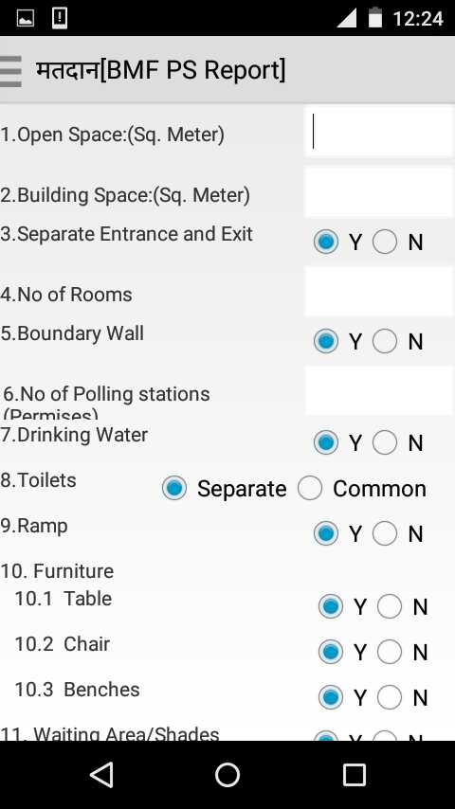
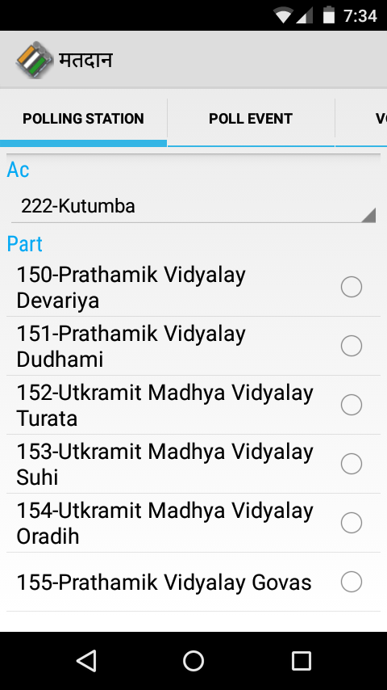
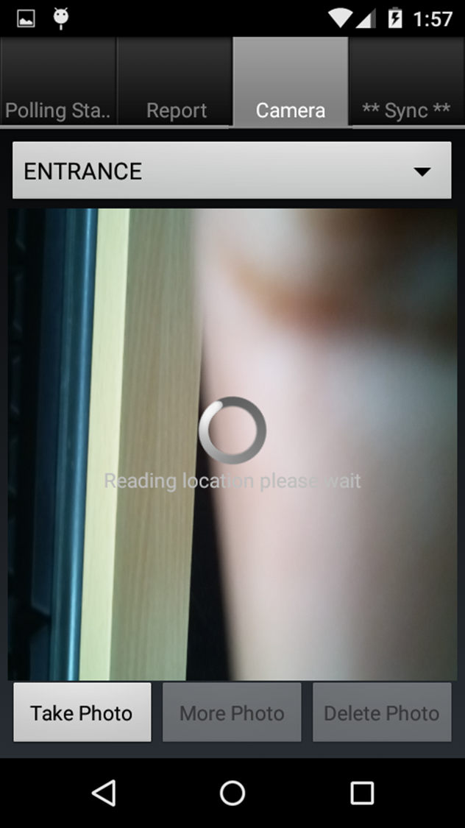
GIS & BMF (Android Application) :

Slide 15
Display at Polling Stations on Poll day
1. Notice on area delineating Polling Stations.
2. Copy of Form 7A.
3. Posters on How to Cast Vote with EVM &
VVPAT.
4. Important telephone nos.
5. Working copy of Electoral Roll.

Slide 16
Thanks

